Slide 1
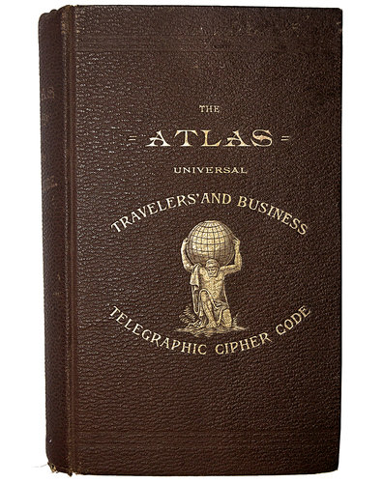

Frank Miller’s Codebook,
1882
Discovered by Steven Bellovin, 2011

Slide 3


Claude Shannon
Claude Shannon
1916-2001

